Slide 1

MEMORY CARDS GAME FLIPPING TILES
GROUP LOOP

Slide 2
INTRO TO GAME
Welcome to the exciting world of Memory Game, where your memory skills will be put to the test!
In this game, you will need to find and match similar components by flipping over cards with various images on them. Remembering the cards' positions is key to finding matching pairs as the game starts with all cards face down. Locate matching pairs amongst the cards to win. Uncovering two cards that do not match means they will be flipped back over, and you need to continue searching for matching pairs.
This AI opponent game is designed to help you improve your memory skills and encourages critical thinking, brain exercises, visual recognition, and long-term memory. An AI opponent makes the game more competitive, adding to its difficulty. The pairing challenge won't have any clues to support you, yet game instructions are available at the help desk.
Success in the game involves finding all matching pairs within a predetermined time limit. Players can easily navigate and enjoy the game thanks to its user-friendly interface. By utilizing Object-Oriented and functional paradigms, the game's developers ensured the program's maintainability and reusability. Experience the excitement of this adventure and try out your memory skills.

Slide 3
FUNCTIONALITY
The memory card game is a game board consisting of several cards, and each card has an image on the front side and is initially facing down. The game functions as follows:
Each time the game starts, the cards will be shuffled so that their positions are unknown to the player.
When the player clicks on the card, it will be flipped over, and the image will be revealed.
If the player flips over two cards that have the same image and it matches, the cards will be removed from the board.
If the player flips over the cards and they don’t match, they will be flipped back to their initial positions.
A tracker to keep the track of the player’s attempts and score.
The time limit will start as soon as the player starts the game, and the player must find the pairs under the given time limits, which makes it more challenging.
The game will end when all the pairs are found, or the limited time runs out.

Slide 4
— Martin Fowler
“Any fool can write code that a computer can understand. Good programmers write code that humans can understand.”

Slide 5
TABLE OF CONTENTS
01
03
02
04
Overview
Functionality of Classes
UML Class Diagram
Play the Demo

Slide 6
01
OVERVIEW

Slide 7
ABOUT THIS GAME
This game is built on JavaFx Library. JavaFX is a well-known framework for developing desktop applications with complex user interfaces. It includes a suite of tools and frameworks that enable developing interactive and aesthetically appealing apps easier.

Slide 8




DEFINITION OF CONCEPTS
OOP
MVC
Event Handling
GUI
Object-Oriented Programming Principles
Model-View-Controller Architecture
Handling the UI Elements’ Events
Graphical User Interface Design
Notes:
OOP:
You have applied OOP principles to structure and organize your code into classes and objects.
This approach helps in encapsulating data and behavior, promoting modularity and reusability.
MVC:
You have likely implemented the MVC architectural pattern to separate the game's logic, user interface, and data representation.
The model represents the game data and rules, the view handles the graphical user interface, and the controller manages the interaction between the model and the view.
Event Handling:
JavaFX provides an event-driven programming model, allowing you to handle user interactions and respond to events such as mouse clicks or key presses.
You have used event handlers to flip cards, track user input, update the game state, and handle other relevant actions.
GUI:
JavaFX's UI controls, layouts, and styling options have enabled you to create an interactive and visually appealing game interface.
You have designed the game board, cards, buttons, labels, and other graphical elements to provide a pleasant user experience.

Slide 9



DEFINITION OF CONCEPTS
Game Logic & Algorithms
Data Structures
Animations
Testing & Debugging
Notes:
Game Logic and Algorithm:
You have implemented the core game logic, including card flipping, matching, and scoring mechanisms.
Algorithms may have been employed to shuffle the cards, check for matches, calculate scores, and manage game progression.
Data Structures:
You may have utilized data structures such as arrays, lists, or maps to store and manage the card information, game state, and scores.
These data structures enable efficient access, manipulation, and organization of game-related data.
Testing & Debugging:
Throughout the development process, you have likely performed testing and debugging to ensure the correctness and reliability of the game.
Unit testing, debugging tools, and techniques have been employed to identify and fix issues or errors in the code.
Animations:
You may have incorporated animations and transitions to enhance the visual appeal and user experience of the game.
JavaFX provides built-in support for animating properties, applying transitions, and creating visual effects.

Slide 10
02
UML CLASS DIAGRAM

Slide 11
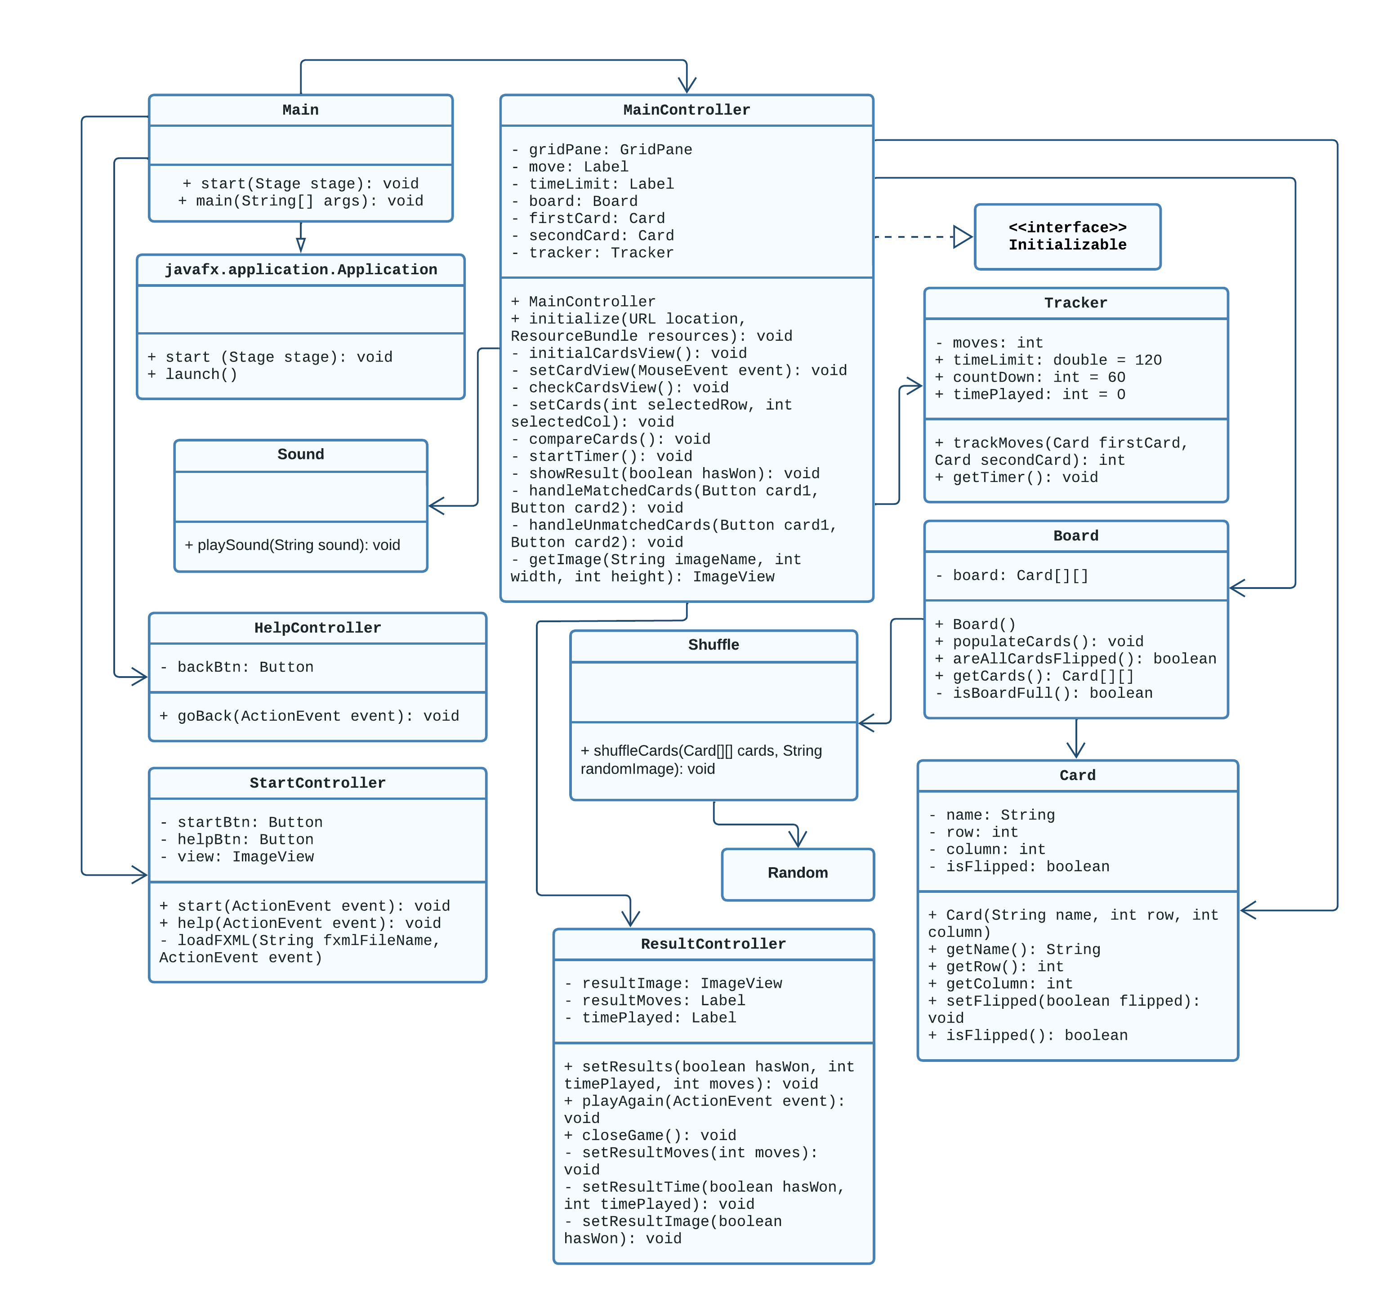
UML REPRESENTATION OF THE PROGRAM

Slide 12
03
FUNCTIONALITY OF CLASSES

Slide 13



Main Class
Initializing the Game
Handling User Interactions
Game Logic Management

Slide 14

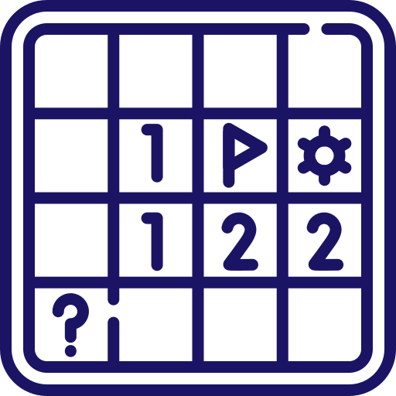

MainController Class
Managing User Interface
Coordinating Game Logic
Handling Game Events

Slide 15



StartController Class
Handling Start Game Actions
Managing Game Settings
Providing Help Option

Slide 16



HelpController Class
Displaying Help Content
Handling Navigation to Main Screen
Providing Contextual Assistance

Slide 17



ResultController Class
Displaying Player Performance
Handling Post-Game Actions
Saving and Loading Player Results

Slide 18
Board Class
Board
Initializing the Game Board
Checking State of the Cards
Board class is responsible for managing the game board.
Updating the Cards

Slide 19
Card Class
Card
Storing Card’s Information
Updating the State of a Card
Card class represents individual cards in the game.
Providing Card’s Information

Slide 20
Shuffle Class
Shuffle
Generating Randomized Card Order
Move Tracking
Shuffle class is responsible for shuffling the cards in the board.
Facilitating Game Initialization

Slide 21
Tracker Class
Tracker
Time Limit Tracking
Applying Shuffled Order
Tracker class is responsible for tracking the time and moves.
Time Played Tracking

Slide 22
Sound Class
Sound
Sound Effect Management
Sound class’s main task is to play a sound effect accordingly.

Slide 23
04
PLAY THE DEMO

Slide 24
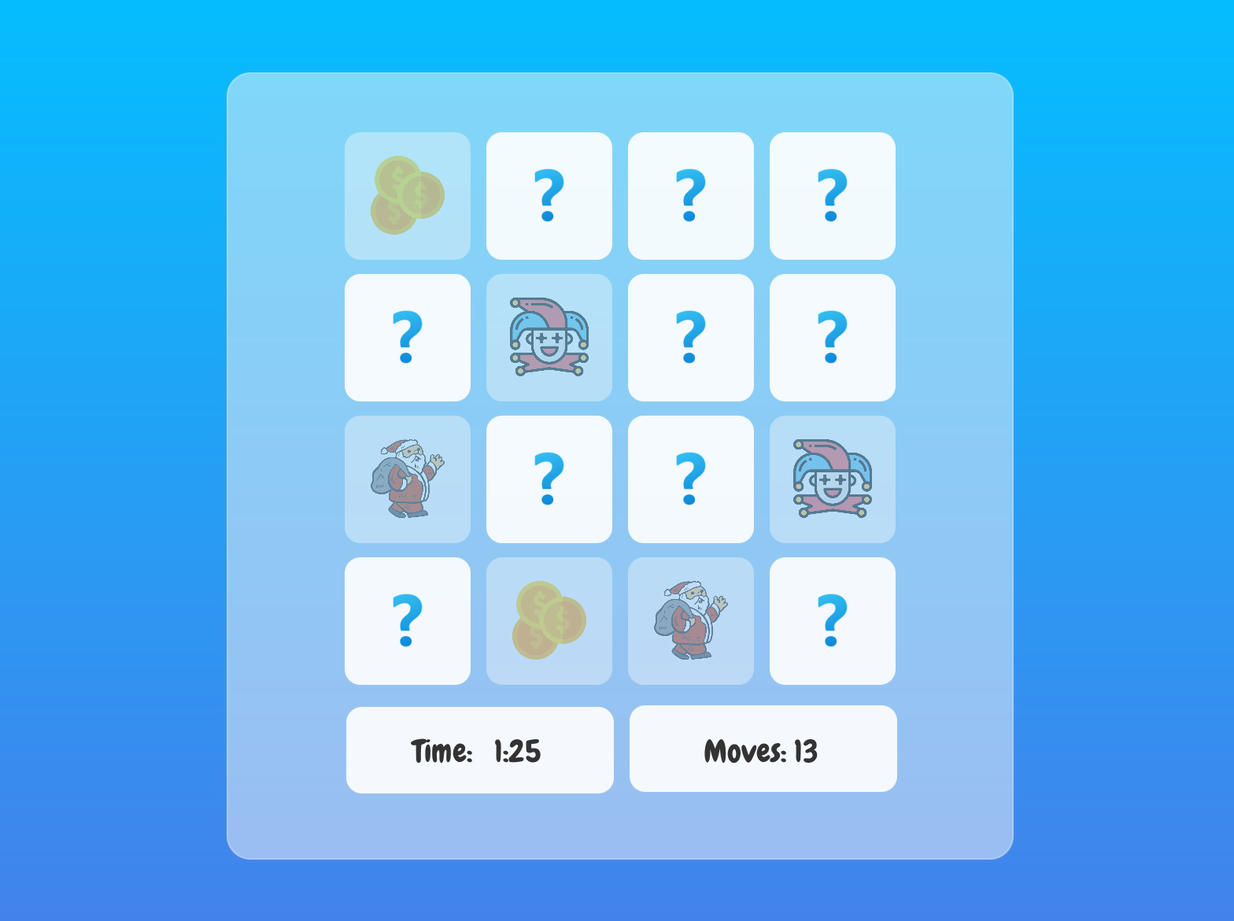
Let’s Play!
Let’s run the program and play the game and see how it functions as it is described.

Slide 25




OUR TEAM
Ahmad F. Azimi
SWE – 1st Year
Role in Team: Programmer
Zeynep Çetin
Engineering - 1st Year
Role in Team:
Team Lead
Efe Mert Güler
CMPE – 2nd Year
Role in Team:
UI Designer
Ceren Kızılırmak
Engineering – 1st Year
Role in Team:
Design Manager

Slide 26
THANKS!
Do you have any questions?
zeynep.cetin@tedu.edu.tr
+90 532 203 99 27
https://github.com/azimifardous/MemoryCard-Project

